Slide 1
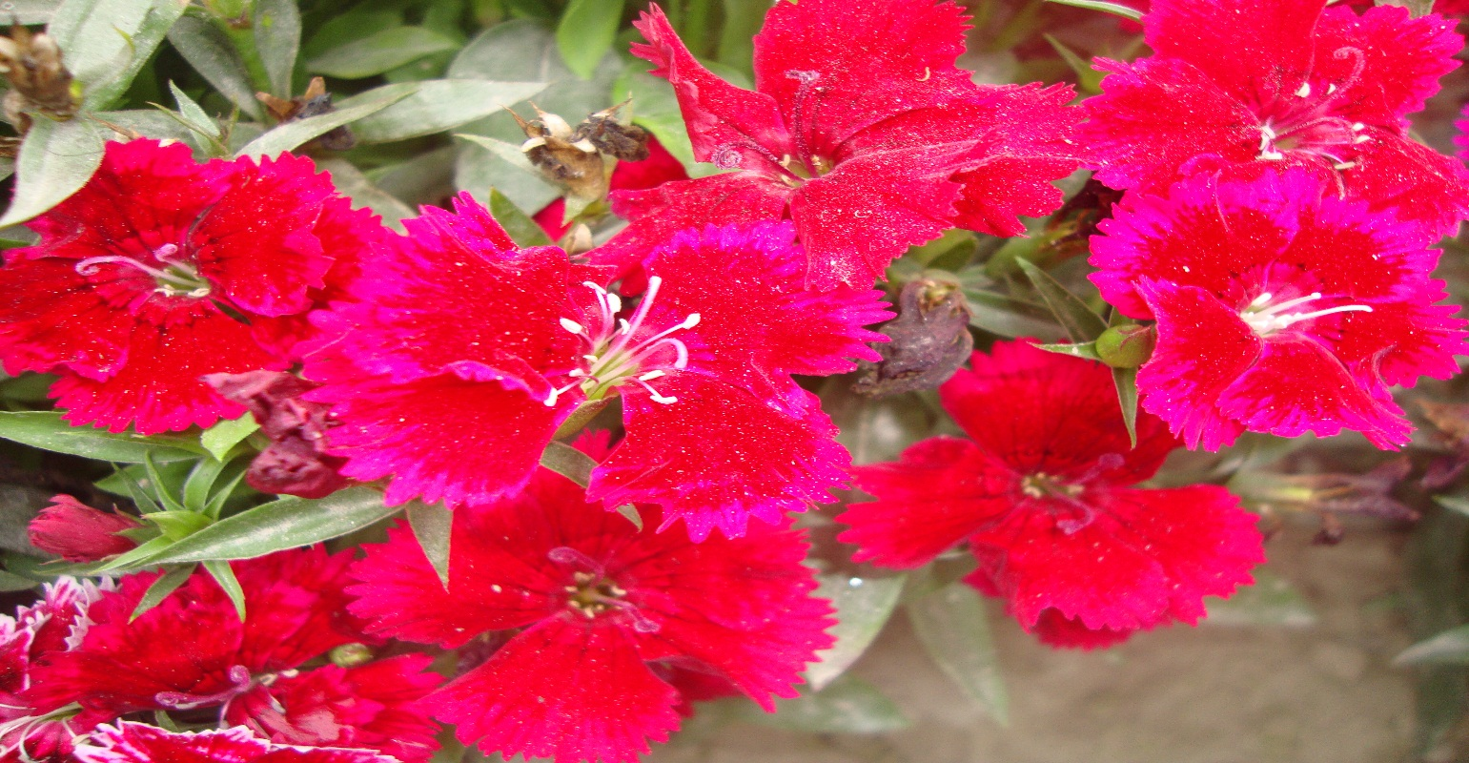
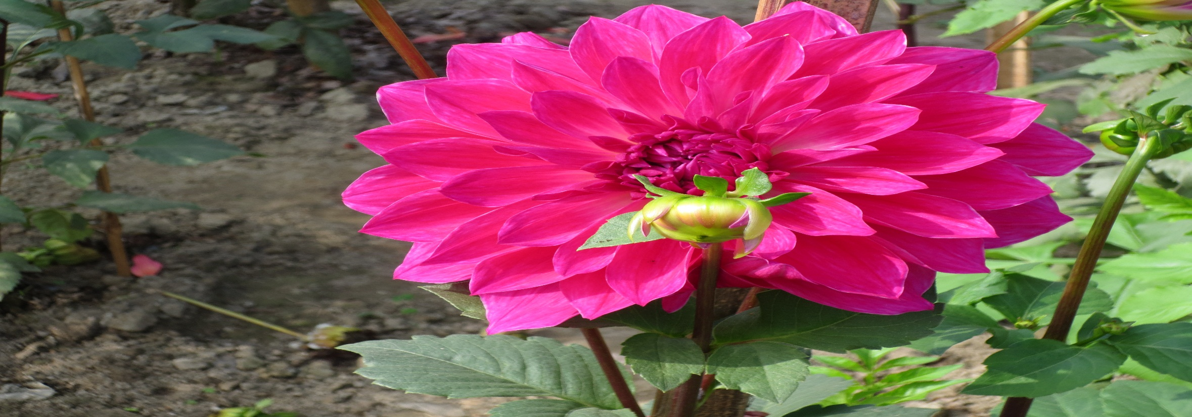
welcome

Slide 2


Introduction Of Teacher
  Md.Abdul Hamid Sarder
Senior Assistant Teacher
Seemanto Public High School
B.G.Batalion Sador Naogaon

Slide 3


Introduction of lesson
Subject: Einglish
Class:Eighit
Unit:Two
Lesson:1
Time:5o minutes

Slide 4
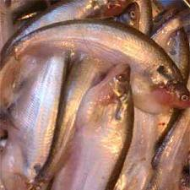
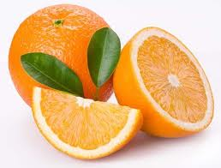
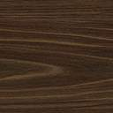
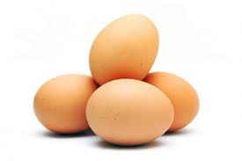
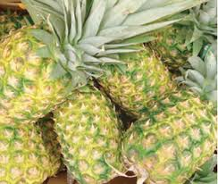
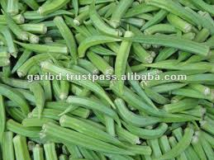
Lesson related
picture
Fruit
Fish
Egg
Pine apple
vegatables

Slide 5
Lesson Declaration
Good Food

Slide 6
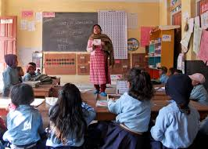
Ideal Reading by the teacher

Slide 7


Learning outcomes
by the end of the lesson the students will able to
Read and understand texts through silent reading.
Ask and question.
Learn about different kinds of food.
Learn about vocab.

Slide 8

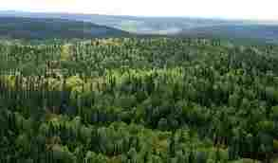
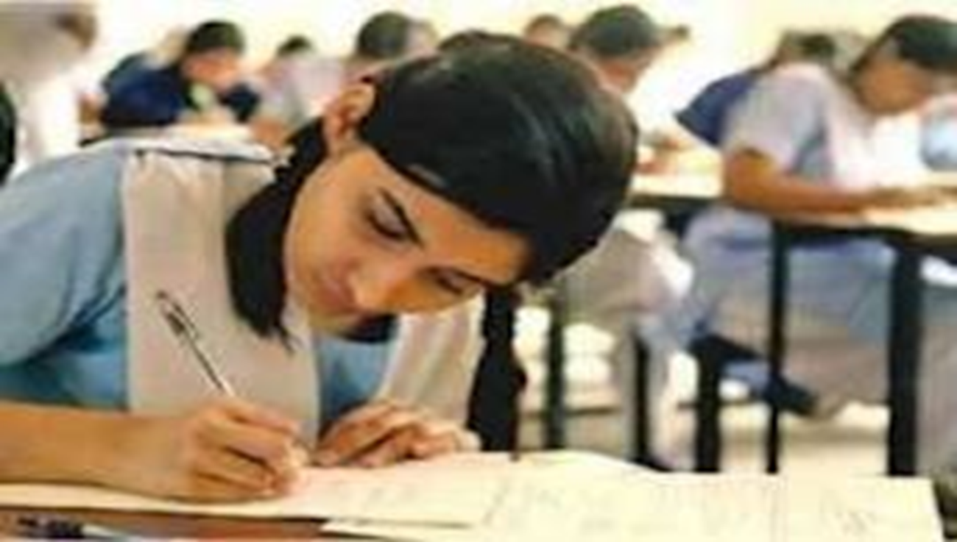
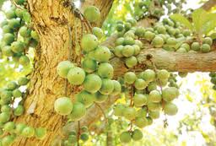
Vocab
Nature:
Class room
Nutrition food
Behave,kinds.
Where Teacher and student meet together to teach and learn
Nutritious food

Slide 9

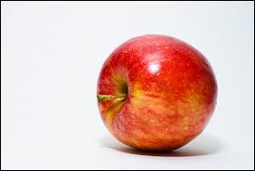
Individual work
5 minutes
(a)What is good food?
(b)What do we eat food?

Slide 10
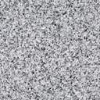
Solution
(a)”Good food means the right kind of food for good health.
(b)We eat food because we can’t live without it.

Slide 11
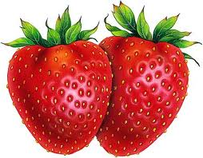

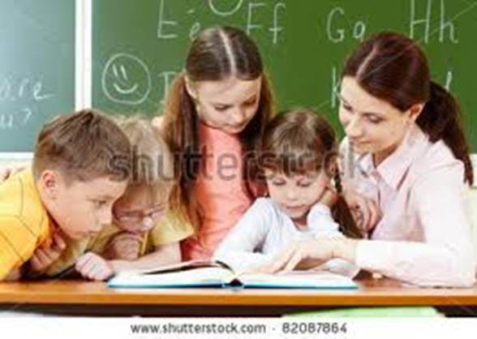
Pair Work
Time: 7 minutes.
(a)What is Ms Rehana Salam talking about?.
(b)What is bad for health?

Slide 12
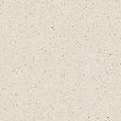
Solution
(a)Ms Rehna Salam,the English
teacher is talking to the class about food.
(b) Eating too much is bad for health.

Slide 13
Evalution
The similar word of student is
(a)man (b)woman ©people (d)pupil
We can not live without--------
(a)Health (b)food .© vitamin (d) sports

Slide 14

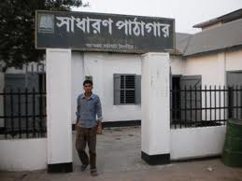
Home Work
Write the substance about “Good Food”
House

Slide 15

Thanks to All

